Slide 1
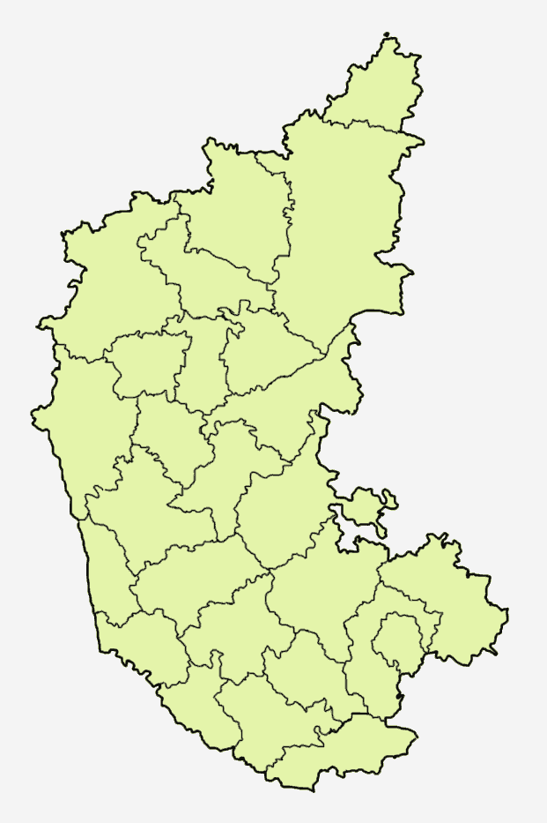
Recommendation after CROP-S

